Slide 1
SOLID Principles of OOD
Chris Gibson
Sameeri Marryboyina

Slide 2


Slide 3
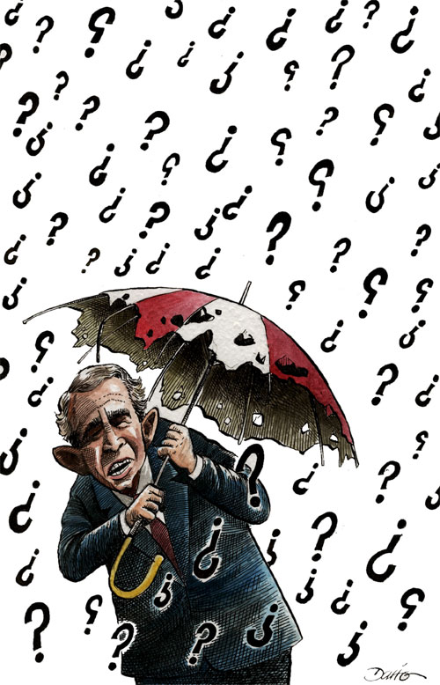
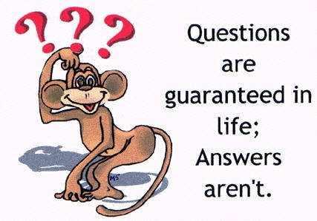

Slide 4
EPP Motivation

Slide 5
Engineering Philosophy
Beautiful, Maintainable Code
We want to “Care” about our code

Slide 6
Norman Rockstars follow Kaizen
Yesterday we have code that works
Today we want to improve it

Slide 7
SOLID Design Principles

Slide 8
What is the only constant in software development?

Slide 9
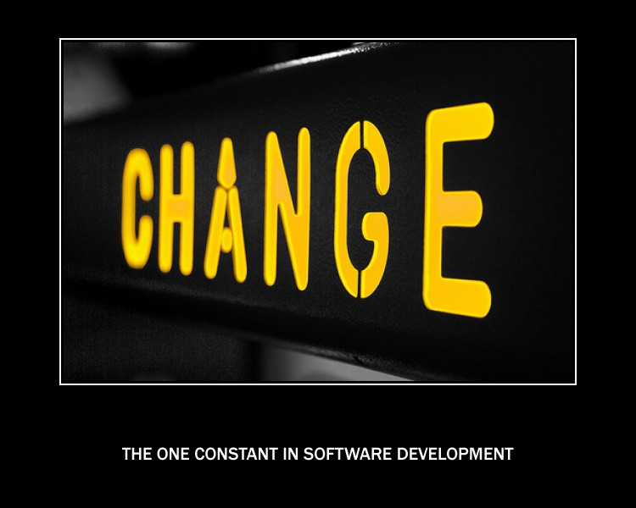

Slide 10
How does our software respond to CHANGE?

Slide 11
TWO KINDS OF PROBLEMS

Slide 12
Code Problems a.k.a Code Smells
Refactoring – Improving the design of existing code [Martin Fowler]
Catalog of smells

Slide 13
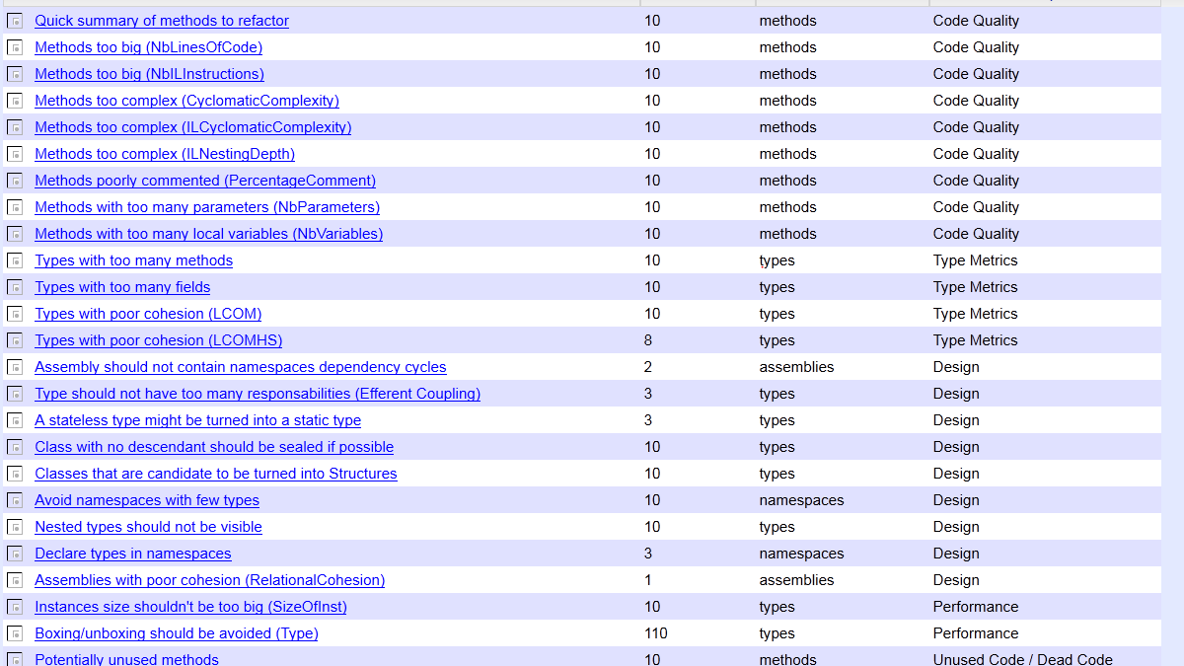
Code Smells: Ndepend Catalog

Slide 14
Design Smells
Agile Principles & Practices[Bob Martin]
Rigidity
Fragility
Viscosity
Immobility

Slide 15
Design?
In 1992, Jack Reeves wrote a seminal article "What Is Software Design?"in the C++ Journal.[1] In this article, Reeves argued that the design of a software system is documented primarily by its source code, that diagrams representing the source code are ancillary to the design and are not the design
itself. The source code is the design.
‘In school, they teach the opposite’.

Slide 16
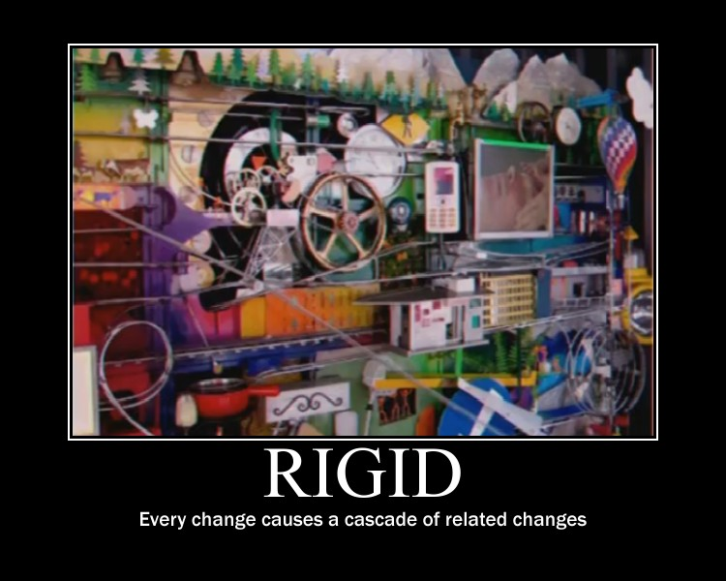

Slide 18
“Rigidity is the opposite of Flexibility. Our Design Sucks if its not Flexible”

Slide 19
RIGIDITY
Rigidity is the tendency for software to be difficult to change, even in simple ways. A design is rigid if a single change causes a cascade of subsequent changes in dependent modules. The more modules that must be changed, the more rigid the design.

Slide 20
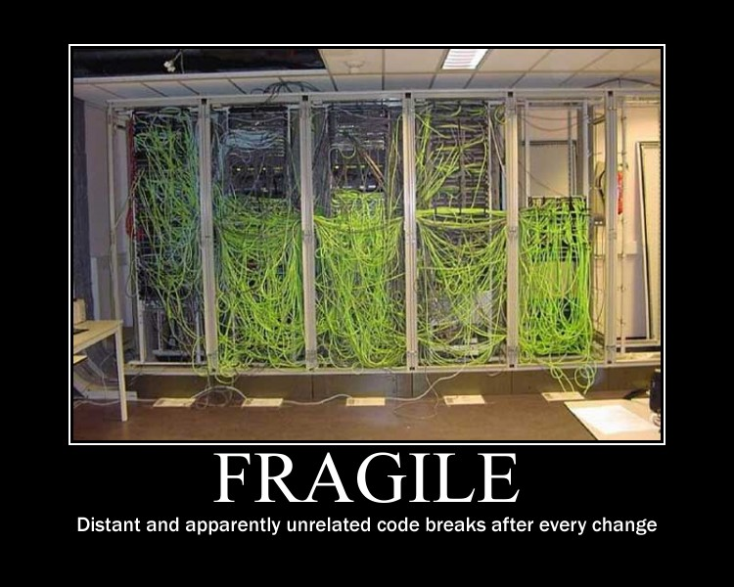

Slide 21
“Does our software break when we try to adapt a change?”

Slide 22
Fragility
Fragility is the tendency of a program to break in many places when a single change is made. Often, the new problems are in areas that have no conceptual relationship with the area that was changed. Fixing those problems leads to even more problems, and the development team begins to resemble a dog chasing its tail.

Slide 23
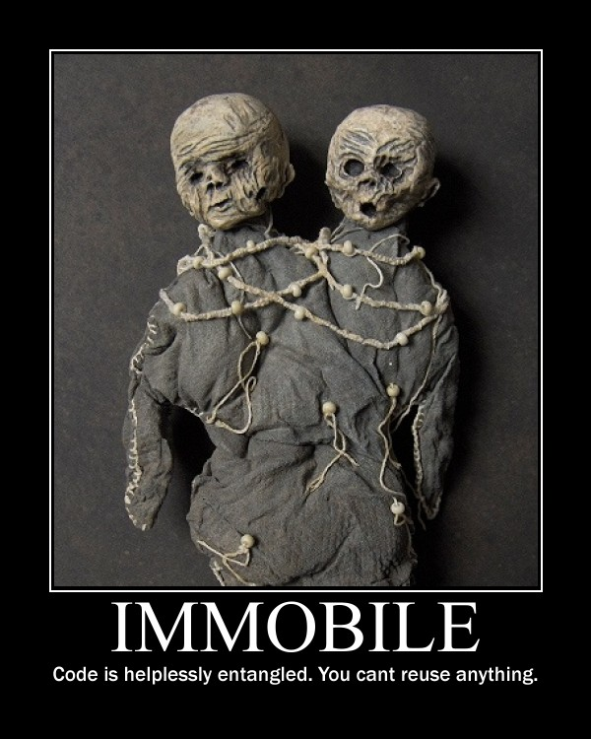

Slide 24
“We cant reuse our beautiful code”
[Or what we think is so beautiful, until our peers challenge it in a code review]

Slide 25
IMMOBILITY
A design is immobile when it contains parts that could be useful in other systems, but the effort and risk involved with separating those parts from the original system are too great. This is an unfortunate but very common occurrence.

Slide 26
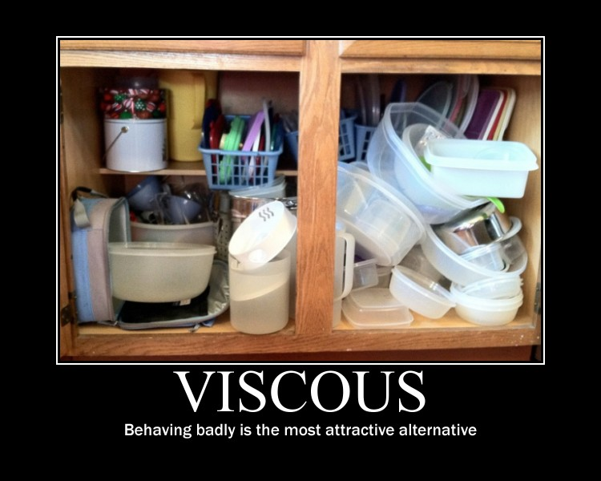

Slide 27
“We can’t maintain/continue/persist a good design”

Slide 28
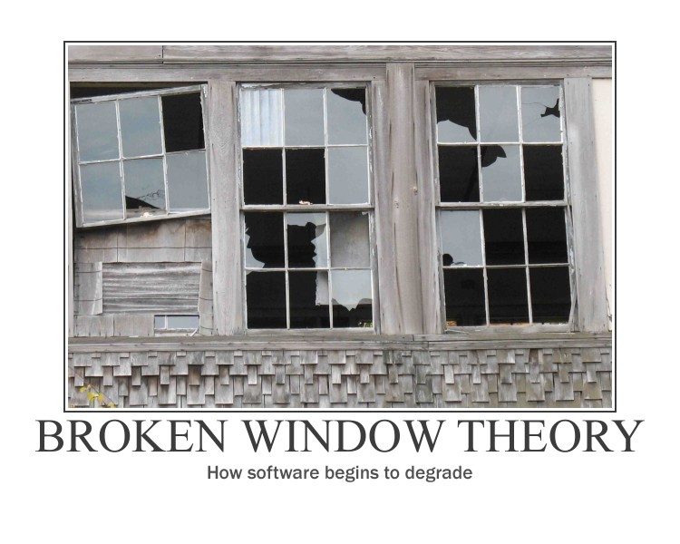

Slide 29
VISCOSITY
A viscous project is one in which the design of the software is difficult to preserve. Friction develops and slows us down. We want to create systems and project environments that make it easy to preserve and improve the
design.

Slide 30
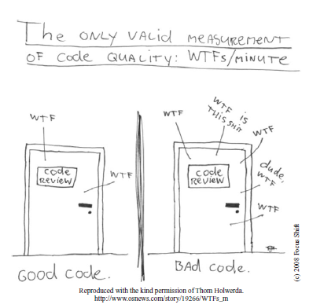
Clean Code

Slide 31

SOLID principles of Object Oriented Design
Single Responsibility Principle
Open/Closed Principle
Liskov Substitution Principle
Interface Segregation Principle
Dependency Inversion Principle
http://butunclebob.com/ArticleS.UncleBob.PrinciplesOfOod

Slide 32

The Acronym SOLID was given by
Micheal Feathers
Author of: Working Effectively with Legacy Code
http://butunclebob.com/ArticleS.MichaelFeathers

Slide 33
SO, WHAT ARE THESE SOLID PRINCIPLES ABOUT?

Slide 34
Better question would be
What problems are they trying to solve?
They are trying to solve a specific set of problems, namely

Slide 35
DEPENDENCY MANAGEMENT ISSUES

Slide 36
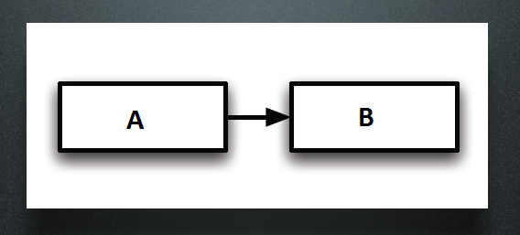
On Dependencies
A IS DEPENDENT ON B. If something happens to B, what effect does it have on A?
DEPENDENCIES GIVE US SOME DEGREE OF REASON TO SEE HOW CHANGES PROPOGATE

Slide 38
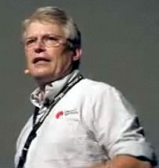
What is Dependency Management?
“Dependency Management is an issue that most of us have faced. Whenever we bring up on our screens a nasty batch of tangled legacy code, we are experiencing the results of poor dependency management. “

Slide 39
Why is Dependency Management so important?
Poor dependency management leads to code that is hard to change, fragile, and non-reusable
On the other hand, when dependencies are well managed, the code remains flexible, robust, and reusable

Slide 40
WHAT IS THE ONE TECHNICAL DEPENDENCY THAT TELOGICAL WANTS TO GET AWAY FROM ASAP?

Slide 41
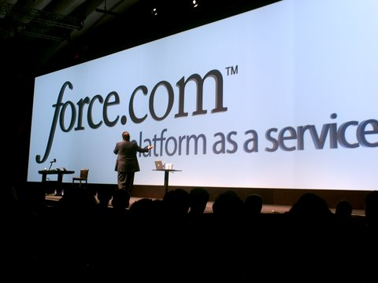

Slide 42
Other OO Developers
Have committed the same kind of design mistakes
Have learnt from those mistakes
Some have specified some GUIDELINES
We can choose to follow or not!
If we choose to follow, we have to understand the problems and where they apply.
If we encounter the same issues, we can meditate on these guidelines and apply them.

Slide 43
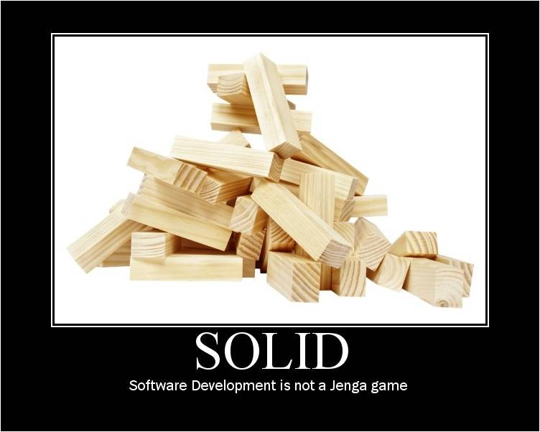

Slide 44
“Talk is cheap, show me the code” - Linus Torvalds

Slide 45
STATIC (C#), DYNAMIC (RUBY)

Slide 46
SINGLE RESPONSIBILITY PRINCIPLE
A CLASS SHOULD HAVE ONE AND ONLY ONE RESPONSIBILITY.
THERE SHOULD NEVER BE MORE THAN ONE REASON FOR A CLASS TO CHANGE.

Slide 47
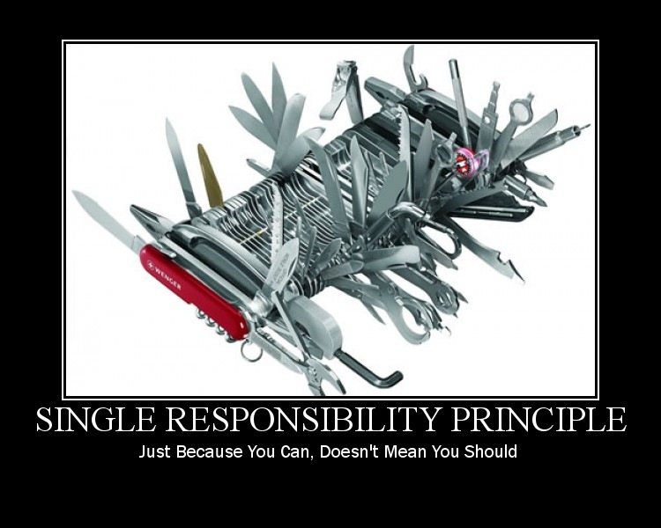

Slide 48
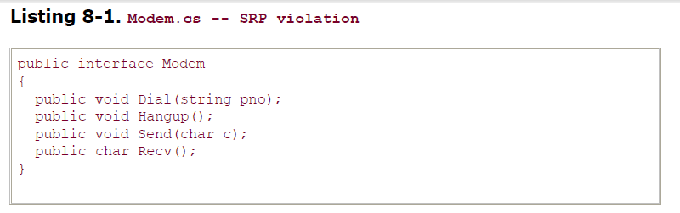
Example from Uncle Bob’s paper

Slide 49
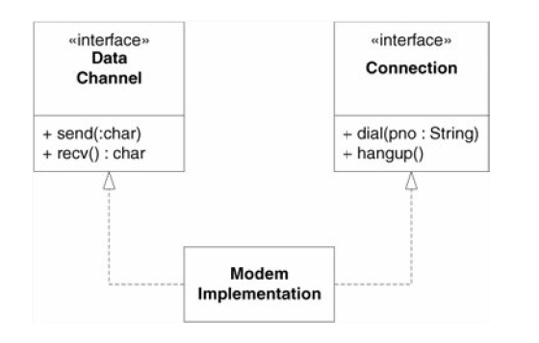

Slide 50
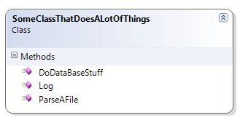
SRP
This principle was described in the work of Tom DeMarco and Meilir Page-Jones.
They called it cohesion, which they defined as the functional relatedness of the elements of a module.

Slide 51
SRP
Why is it important to separate two responsibilities into separate classes?
Because each responsibility is an axis of change. When the requirements change, that change will be manifest through a change in responsibility amongst the classes. If a class assumes more than one responsibility, then there will be more than one reason for it to change.
If a class has more then one responsibility, then the responsibilities become coupled. Changes to one responsibility may impair or inhibit the class’ ability to meet the others. This kind of coupling leads to fragile designs that break in unexpected ways when
changed.

Slide 52
SRP
Responsibility means a reason to change. Responsibility is an axis for change.
Change in requirements are often the case.
Following the Single Responsibility Principle can lead us to our goal of Strong Cohesion & Loose Coupling.
Many small classes with distinct responsibilities results in a more flexible design.
The SRP is one of the simplest of the principle, and one of the hardest to get right.
Conjoining responsibilities is something that we do naturally.
Finding and separating those responsibilities from one another is much of what software design is really about.
Multiple small interfaces that follow Interface Segregation Principle can help in achieving SRP.

Slide 53
OPEN/CLOSED PRINCIPLE
SOFTWARE ENTITIES (CLASSES, MODULES, FUNCTIONS, ETC.) SHOULD BE OPEN FOR EXTENSION, BUT CLOSED FOR MODIFICATION.

Slide 54
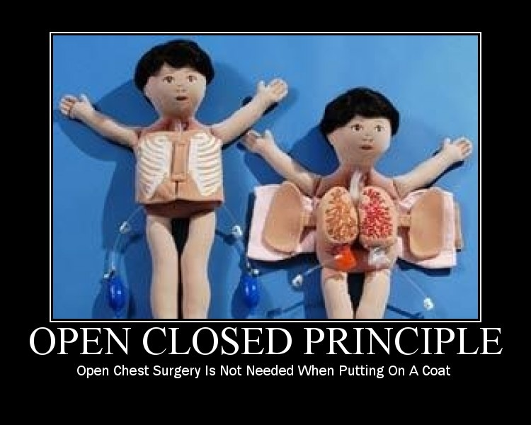

Slide 55
OCP
Open to Extension : New Behavior can be added in the future
Closed to Modification: Changes to existing code is not required.

Slide 56
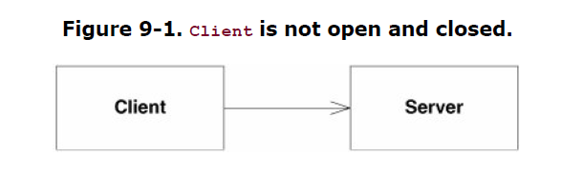
Example from Uncle Bob’s paper

Slide 57
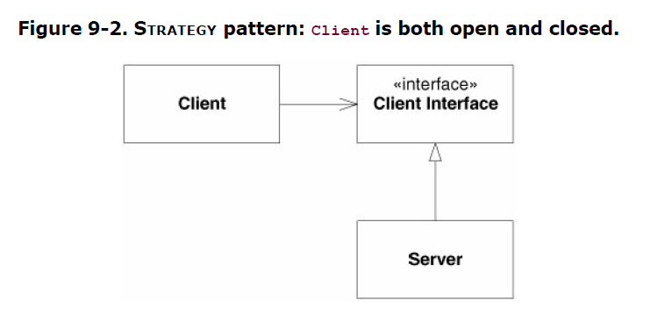
“Abstraction” is the key

Slide 58
OCP
The OCP Principle was given by Bertrand Meyer
OCP is at the heart of Object Oriented design
Conformance to OCP yields the greatest benefits of OOD, reusability & maintainability
Key to OCP is programming to abstractions.
Do not depend on implementations, depend on abstractions.
100 % Conformance to OCP is not possible. There might be a requirement that may render our code not closed.
Since closure cannot be complete, it should be strategic.
Developer must choose what changes the code can be closed to.
Experience would help a developer to make choices and design code for the most probable causes of change.

Slide 59
LISKOV SUBSTITUTION PRINCIPLE
FUNCTIONS THAT USE POINTERS OR REFERENCES TO BASE CLASSES MUST BE ABLE TO USE OBJECTS OF DERIVED CLASSES
WITHOUT KNOWING IT.

Slide 60
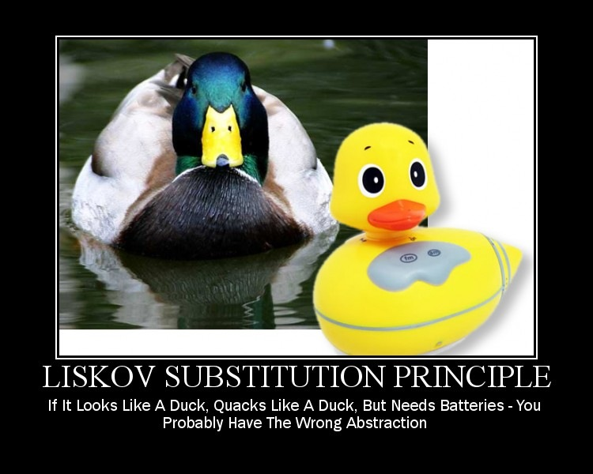

Slide 61
LSP
The above is a paraphrase of the Liskov Substitution Principle
Barbara Liskov first wrote it as follows :
If for each object o1 of type S there is an object o2 of type T such that for all programs P defined in terms of T, the behavior of P is unchanged when o1 is substituted for o2 then S is a subtype of T.

Slide 62
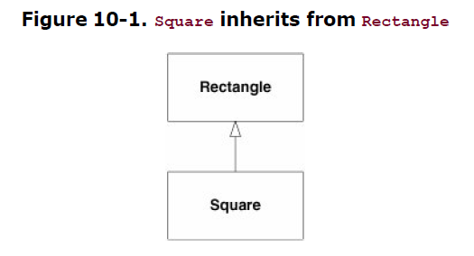
Example from Uncle Bob’s paper

Slide 63
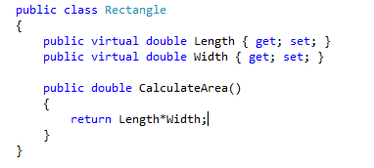
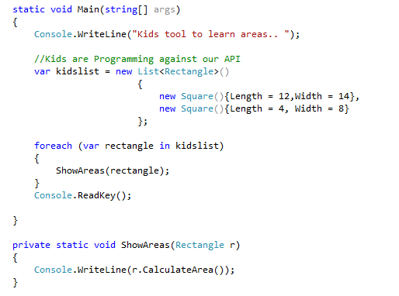
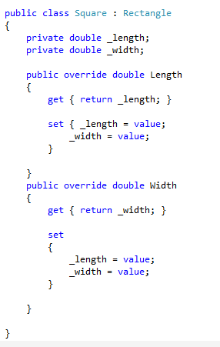
What we thought to be code reuse with inheritance causes a problem

Slide 64
LSP
Named after Barbara Liskov, who gave the principle in 1988.
Substitutability
Calling code must not know the difference between a derived type and a base type.
Sub-types must be substitutable for their base types.
Child classes should not remove base class behavior.
Native OOP: "IS-A" relationship
LSP : "IS-SUBSTITUTABLE=FOR“
LSP surfaces the undesired behavior problems in subtypes caused due to inheritance

Slide 65
INTERFACE SEGREGATION PRINCIPLE
CLIENTS SHOULD NOT BE FORCED TO DEPEND UPON INTERFACES THAT THEY DO NOT USE.

Slide 66
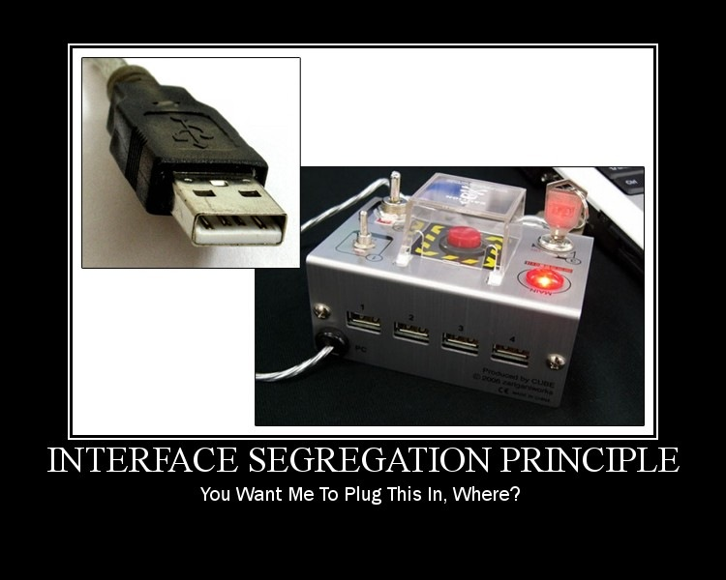

Slide 67
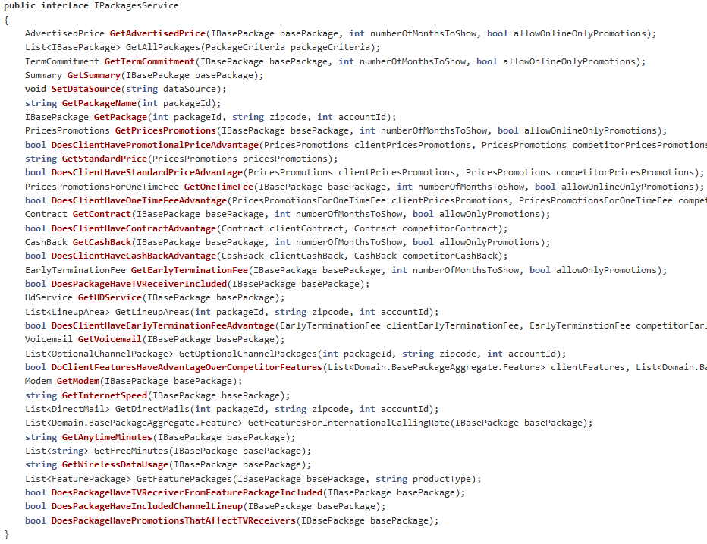

Slide 68
ISP
Fat/Polluted interfaces
Classes that have “fat” interfaces are classes whose interfaces are not cohesive.
Let the client drive the interface.
In other words, the interfaces of the class can be broken up into groups of member functions. Each group serves a different set of clients. Thus some clients use one group of member functions, and other clients use the other groups.
The ISP acknowledges that there are objects that require non-cohesive interfaces; however it suggests that clients should not know about them as a single class. Instead, clients should know about abstract base classes that have cohesive interfaces.
Some languages refer to these abstract base classes as “interfaces”, “protocols” or “signatures”.

Slide 69
DEPENDENCY INVERSION PRINCIPLE
A. HIGH LEVEL MODULES SHOULD NOT DEPEND UPON LOW LEVEL MODULES. BOTH SHOULD DEPEND UPON ABSTRACTIONS.
B. ABSTRACTIONS SHOULD NOT DEPEND UPON DETAILS. DETAILS SHOULD DEPEND UPON ABSTRACTIONS.

Slide 70
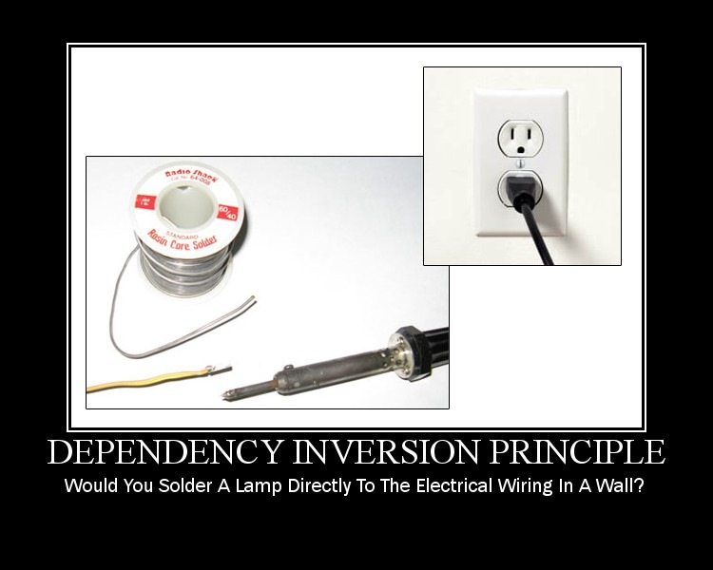

Slide 71
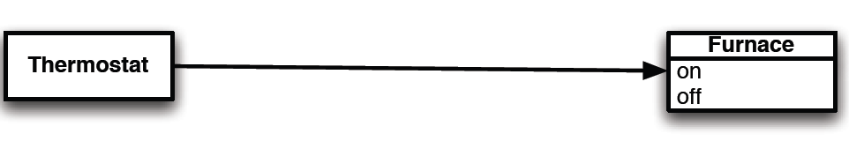
The Thermostat Problem

Slide 72
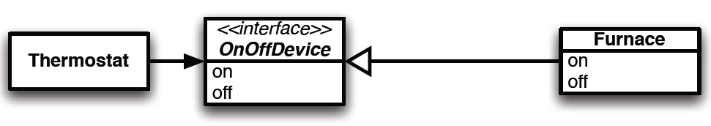

Slide 73
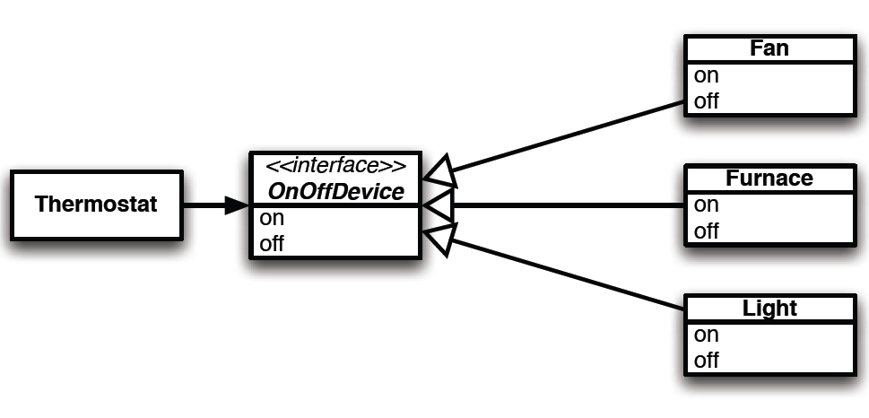

Slide 74
DIP
Code to an abstraction, not an implementation
Dependencies can also include libraries, files, file system, mail service, ftp, sftp, databases etc
Tools to recognize dependencies: Ndepend, VS Ultimate Architecture tab

Slide 75
In the API, How can we swap the existing ORM NHibernate with another ORM such as Entity FW or more still MongoDB as the DB?

Slide 76
STATIC vs. DYNAMIC

Slide 77
Why do we need an Interface?

Slide 78

In static languages, We must know about Types being passed around!

Slide 79
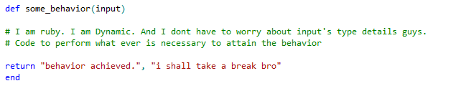
A dynamic language like Ruby is designed to never worry about types in the first place

Slide 80
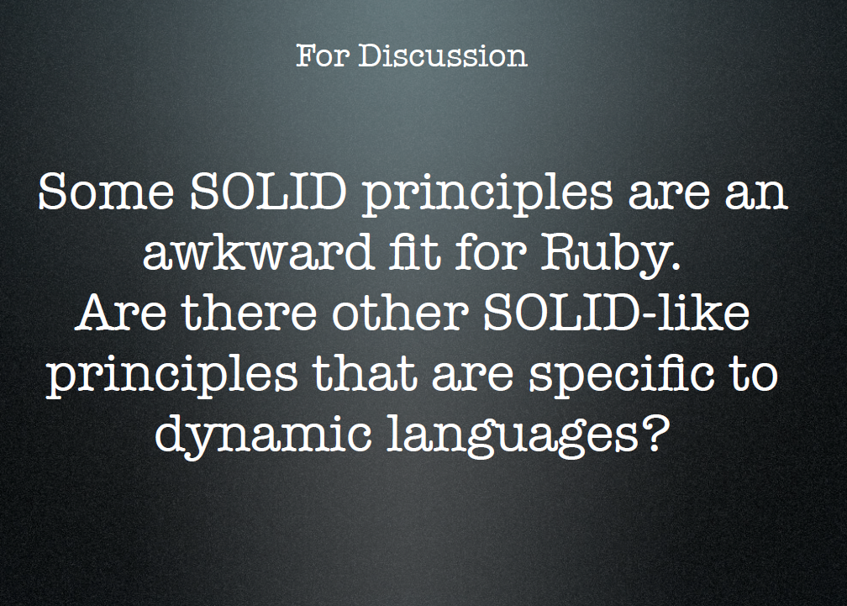
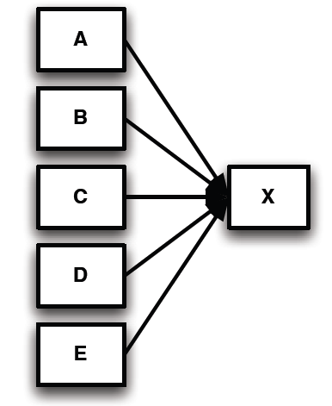
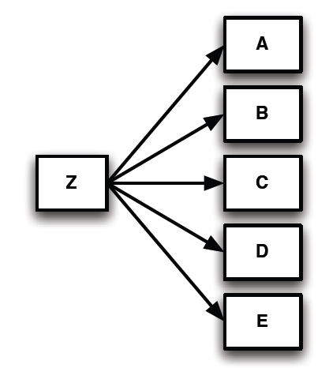
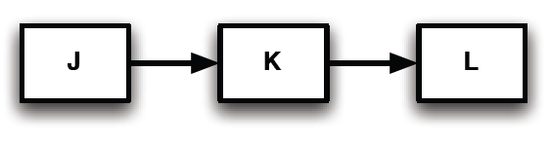

Slide 81
Other design smells & principles
Needless Repetition : DRY
Complex/Over design : YAGNI, KISS

Slide 82
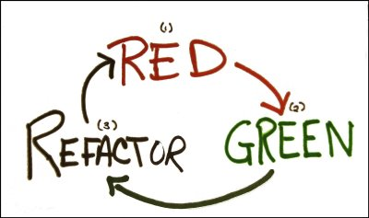
When to apply SOLID design principles
TDD presents us an opportunity

Slide 83
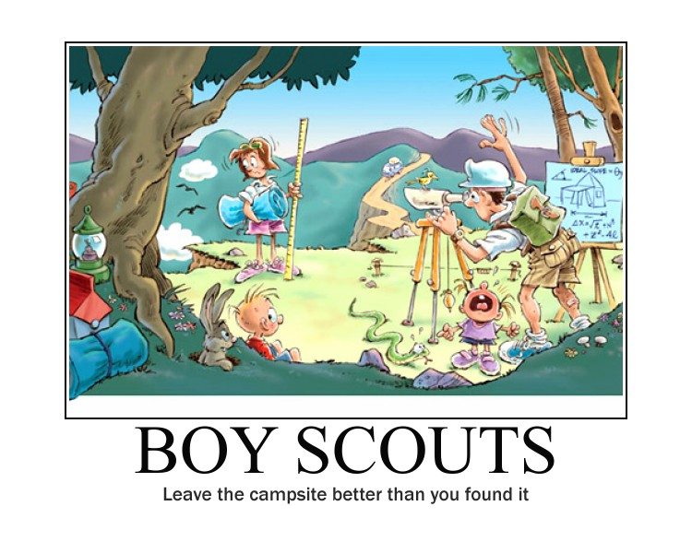

Slide 84
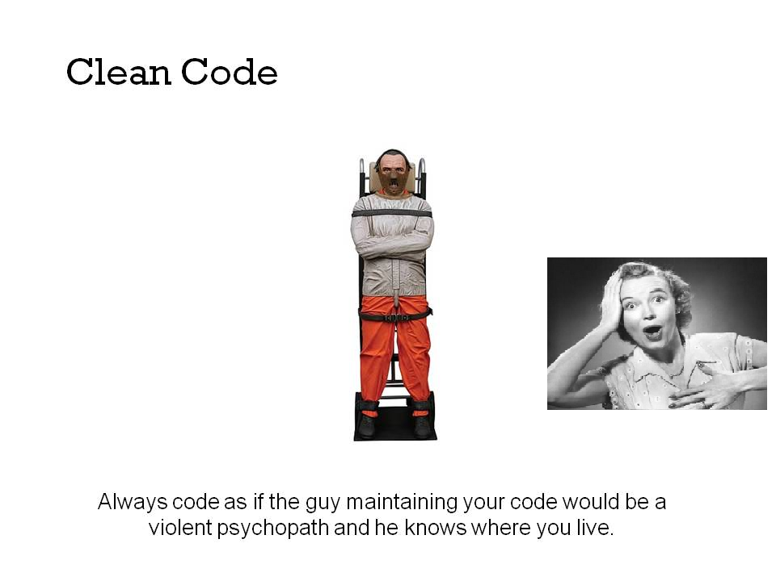

Slide 85
What Next?

Slide 86

Mediate on these principles

Slide 87
For us, its constant learning
Design Patterns
Refactoring to Patterns
Architectural Patterns
Patterns in JavaScript

Slide 88
Code, presentation can be found at
https://github.com/chris-gibson/solid

Slide 89
References
http://butunclebob.com/ArticleS.UncleBob.PrinciplesOfOod
http://lostechies.com/derickbailey/2009/02/11/solid-development-principles-in-motivational-pictures/
http://bighugelabs.com/motivator.php
http://www.developerdotstar.com/mag/bios/jack_reeves.html

Slide 90
Ruby SOLID Principles
http://blip.tv/rubynation/jim-weirich-3672101
http://www.confreaks.com/videos/240-goruco2009-solid-object-oriented-design

Slide 91


